Slide 1


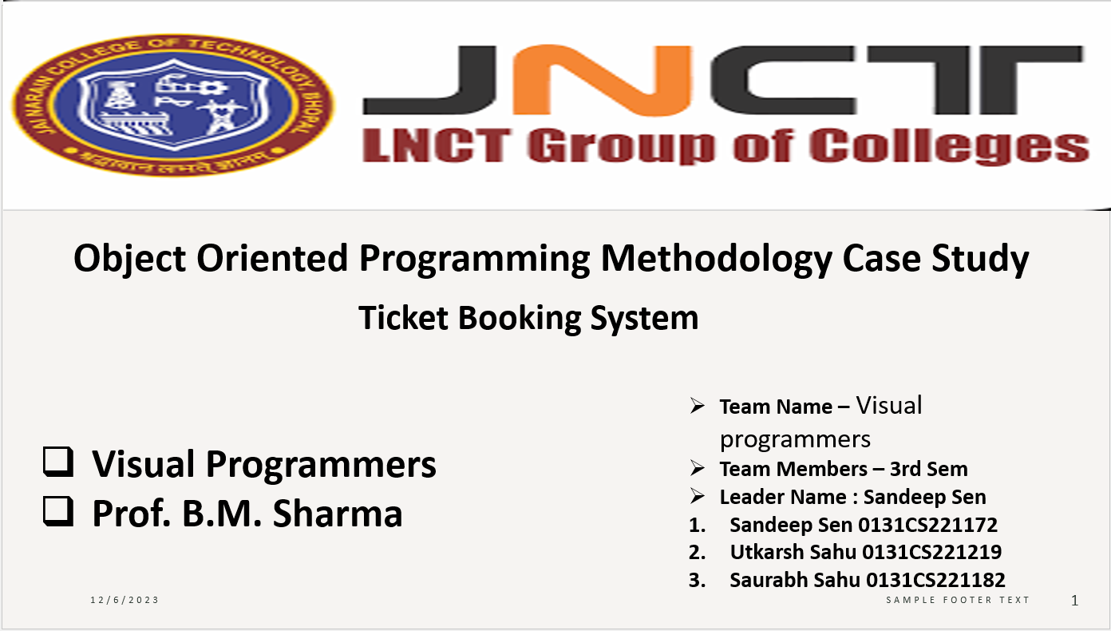
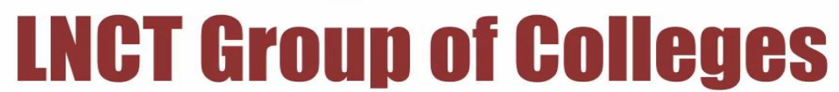

Prof. Brij Mohan Sharma

Slide 2
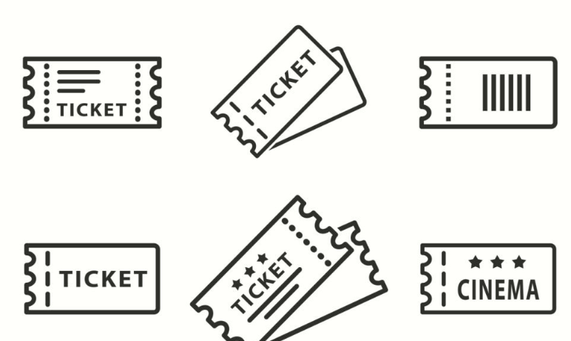
Summary of 1st Presentation
===============================================================================
Need of Ticket Booking System
Benefits of Ticket Booking System
Advantages of Ticket Booking System
Study of Ticket Booking System
Proposal of Ticket Booking System
Input – Output of Ticket Booking System

Slide 3

Index for 2nd Presentation
==============================================================
Ticket Booking System using Use-Case diagram
Ticket Booking System using Class – Object diagram
Input – Output flow of Ticket Booking System
Purpose of using Ticket Booking System

Slide 4
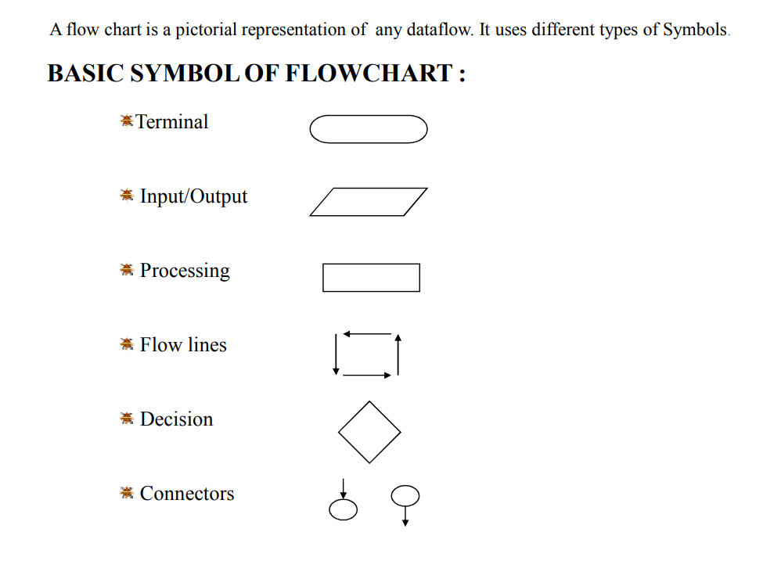

Slide 5
Cases used in Ticket Booking System
================================================================
Search for events: The user can search for events based on various criteria, such as event type, location, date, and time.
Select event: The user can select an event from the search results to view more details.
View event details: The user can view the event details, including the event description, venue information, ticket prices, and seating availability.
Choose seats: The user can select the desired seats from the seating chart.
Enter personal details: The user enters their personal information, such as name, email address, and contact number, to complete the booking process.
Make payment: The user selects the desired payment method and enters their payment information to make the payment.

Slide 6
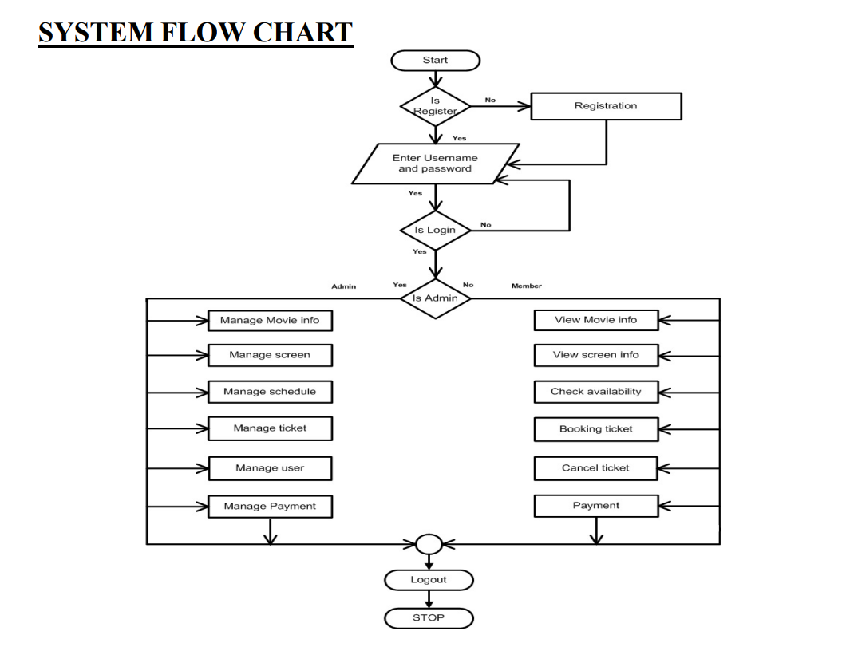

Slide 7
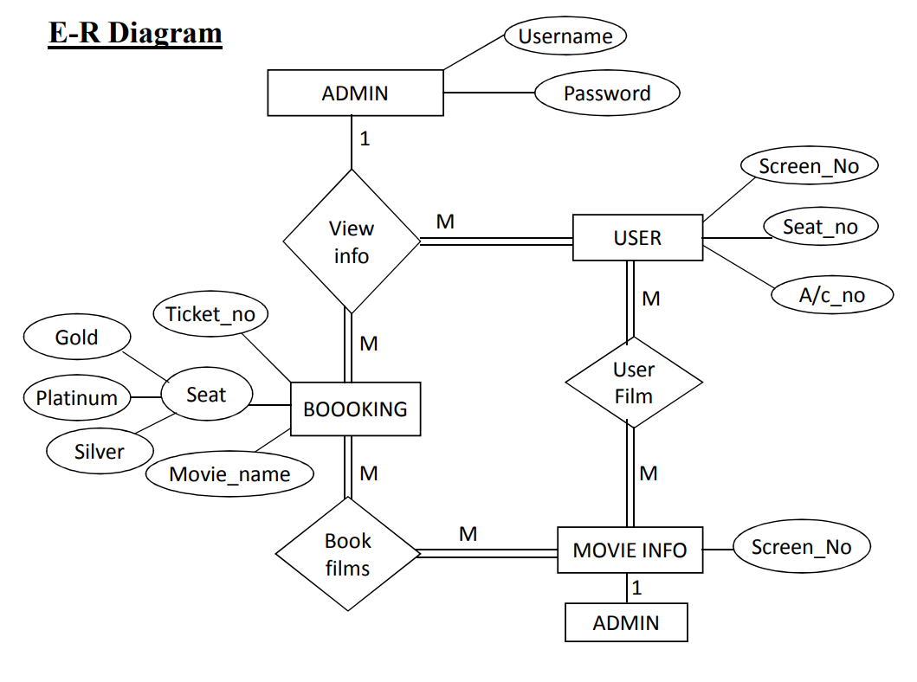

Slide 8
UML Diagrams
========================================
UML stands for Unified Modeling Language. UML diagrams play a crucial role in designing and developing a comprehensive ticket booking system. They provide a standardized visual language to represent the system's structure, behavior, and interactions, enabling effective communication and collaboration among stakeholders.
UML diagrams are used to model different aspects of a system, including:
Structure: UML diagrams can be used to show the classes, objects, components, and relationships in a system.
Behavior: UML diagrams can be used to show how a system behaves, including its processes, interactions, and use cases.
Implementation: UML diagrams can be used to show how a system is implemented, including its code, databases, and deployment diagrams.

Slide 9
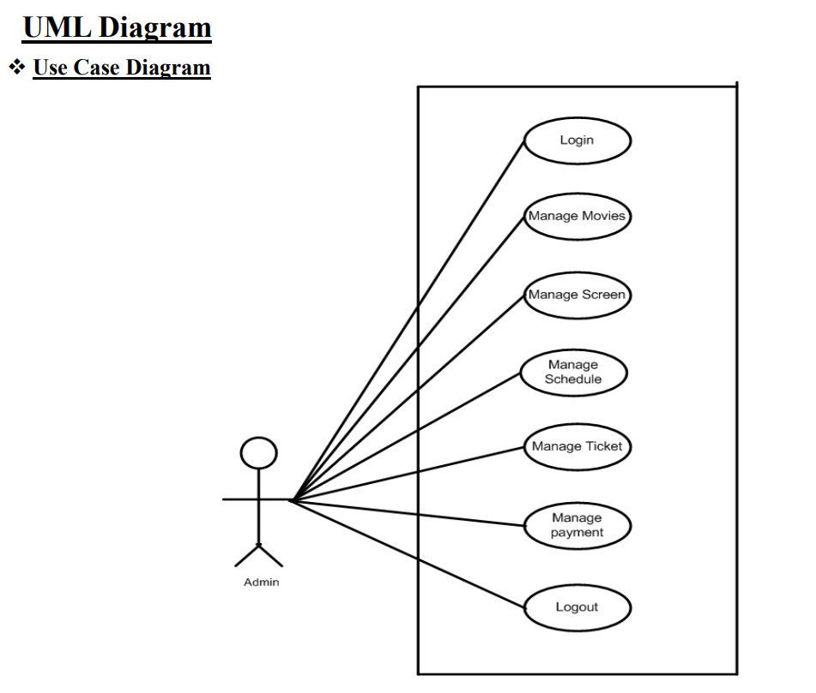

Slide 10
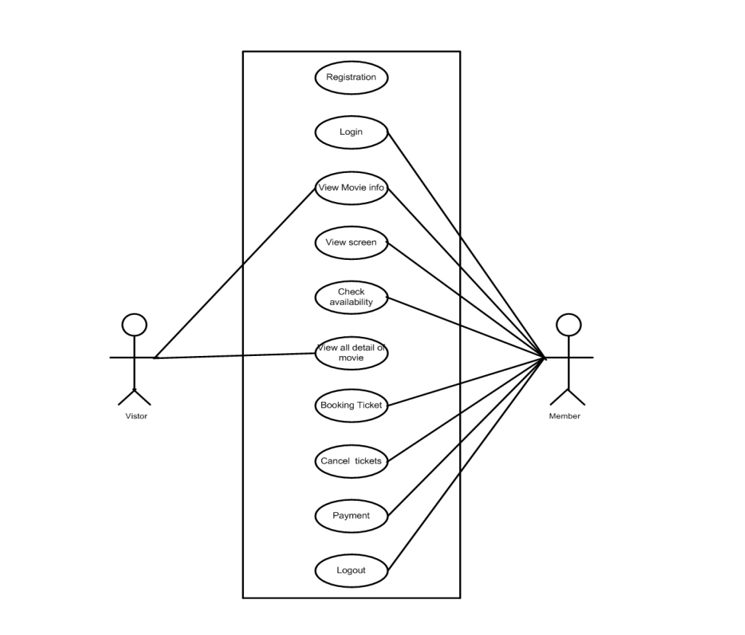

Slide 11
Ticket Booking System using Class-Object diagram
===================================================================================
User: Represents a user of the system, including their personal information, booking history, and preferences.
Event: Represents an event that can be booked, including its name, description, date, time, venue, performers, and ticket prices.
Ticket: Represents a ticket for an event, including its type, price, seat number, and associated event.
Booking: Represents a booking made by a user, including the user, event, tickets, and payment information.
Payment: Represents a payment made for a booking, including the payment method, amount, and status.
Seat: Represents a seat in a venue, including its row, number, and status (available or booked).
Venue: Represents a venue where events take place, including its name, address, capacity, and seating layout.

Slide 12
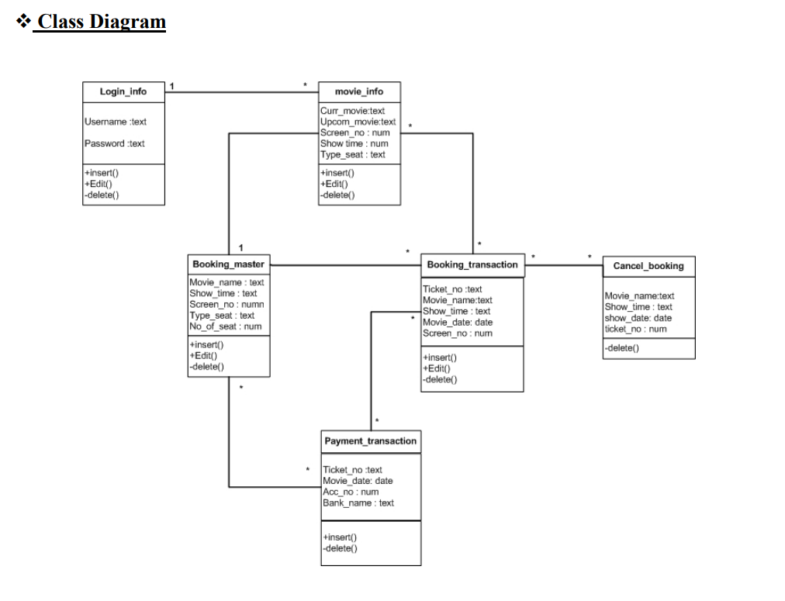

Slide 13
Input – Output Analysis of Ticket Booking System
==============================================================================
Stage 1: User Search and Selection
Input:
User search criteria (keywords, event type, location, date, time)
Output:
List of events matching the search criteria
Event details (description, venue, date, time, performers, ticket prices)
Seating chart (available and booked seats)
Stage 2: Booking Selection and Confirmation
Input:
Selected event and ticket type
Chosen seats
User personal information (name, email address, contact number)
Payment information (credit card, debit card, PayPal)
Output:
Booking confirmation with details (event, ticket type, seat numbers, price, payment confirmation)
Ticket(s) (electronic or printable)
Stage 3: Booking Management and Support
Input:
Booking confirmation number
User requests (cancellation, change of booking, refund)
Output:
Confirmation of booking changes or cancellations
Refund information (if applicable)
Updated booking details
Customer support assistance (via email, phone, chat)
Additional Inputs and Outputs:
User reviews and ratings of events and venues
Communication between users and event organizers
Ticket validation at event entry
Data integration with external systems (payment gateways, ticketing platforms)

Slide 14
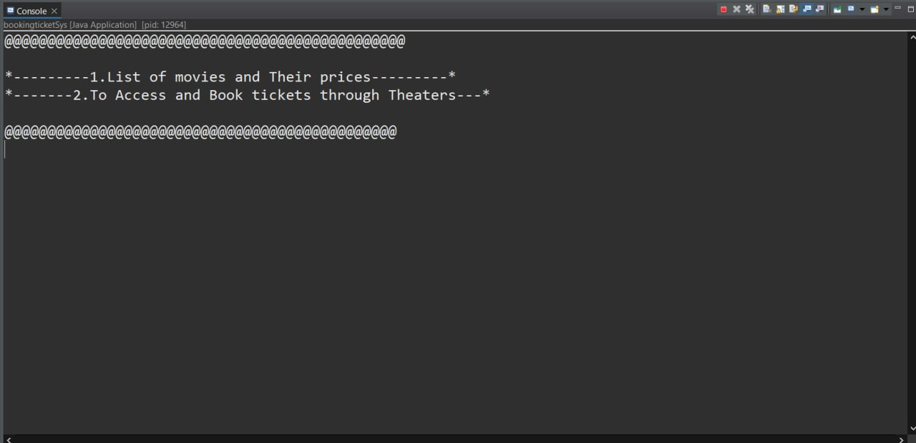

Slide 15
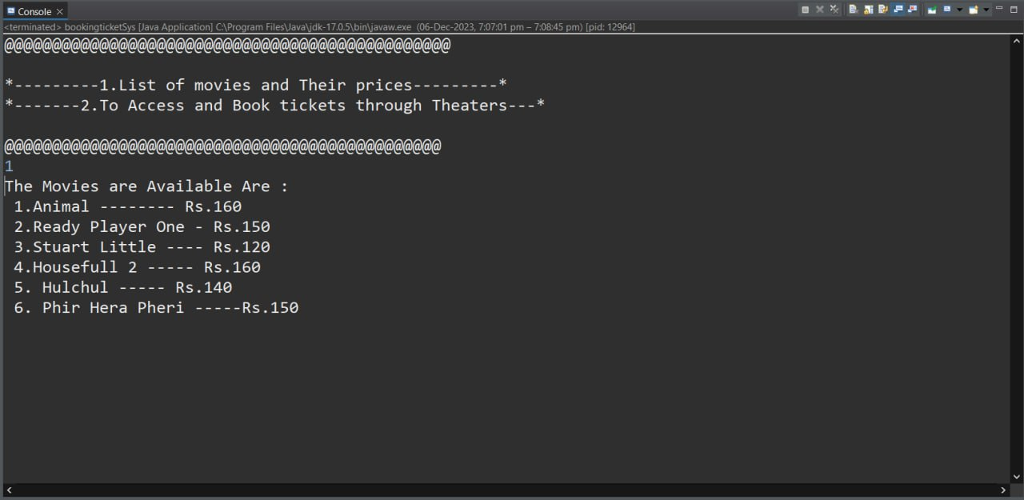

Slide 16
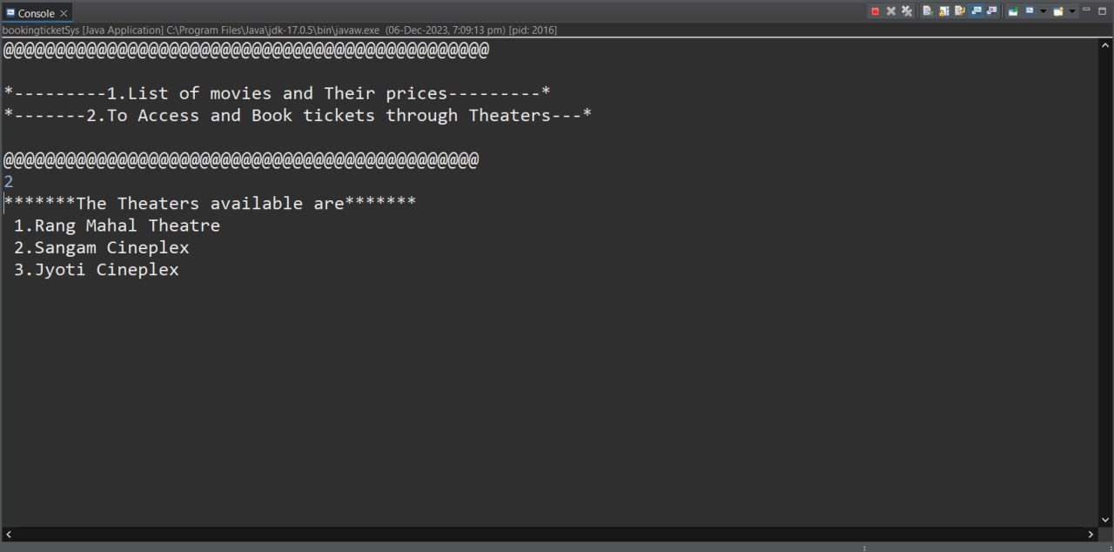

Slide 17
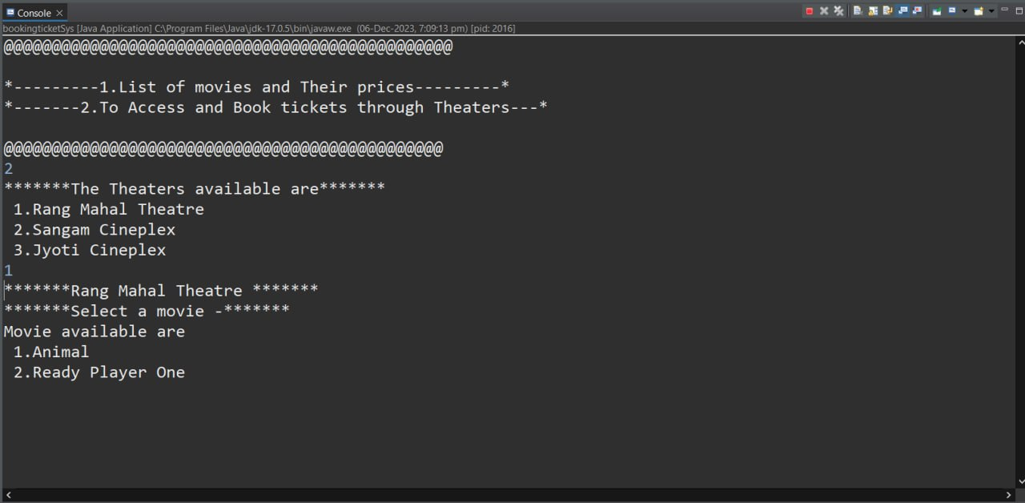

Slide 18
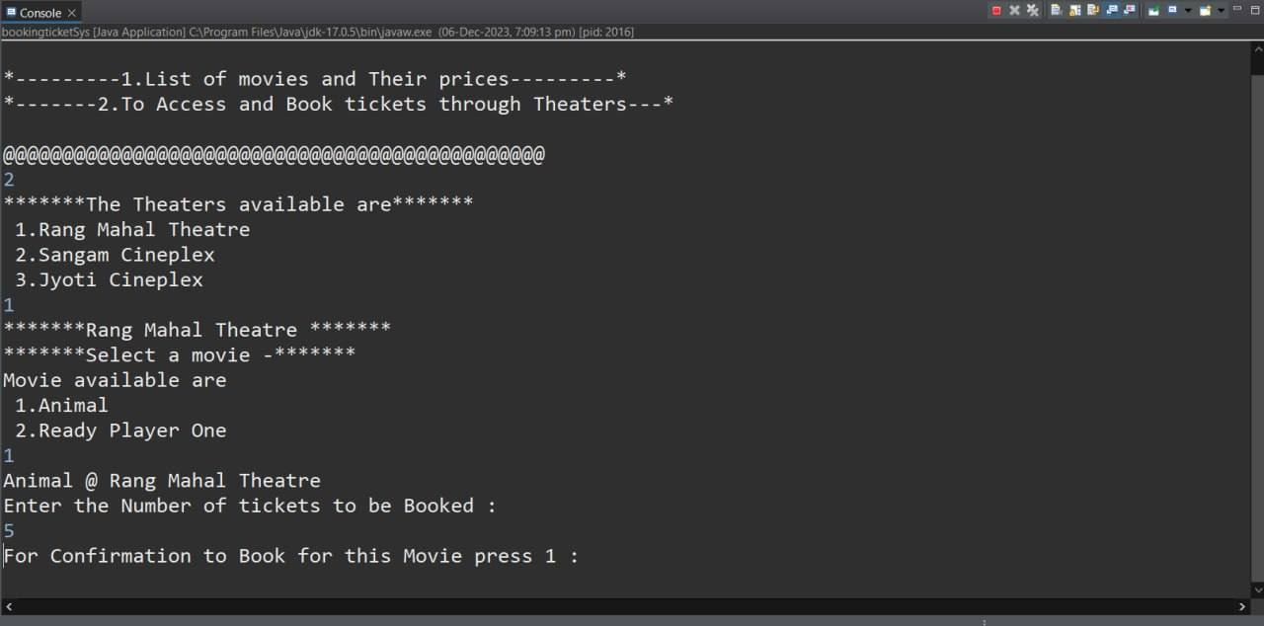

Slide 19
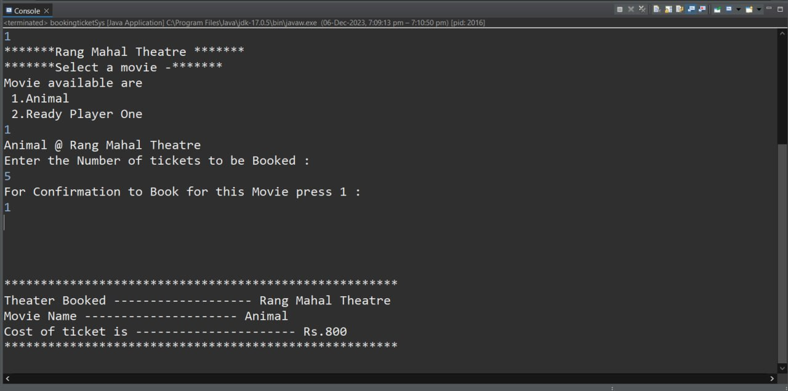

Slide 20
Use of OOPM in Ticket Booking System
=====================================================================================
Classes and Objects:
Classes: Represent real-world entities like User, Event, Ticket, Booking, Seat, and Venue. Each class defines attributes (properties) and methods (functions) specific to that entity.
Objects: Instances of classes, representing specific entities within the system. For example, a User object can represent an individual user with their unique information and booking history.
Encapsulation:
Hides internal data and functionality of each class, ensuring data integrity and preventing unauthorized access.
Only specific methods can access and modify data, promoting controlled manipulation and ensuring consistency.
Inheritance:
Enables creating new classes (subclasses) that inherit properties and methods from existing classes (super classes).
Promotes code reuse and reduces redundancy, making the system more maintainable and scalable.
For example, a VIP User class can inherit attributes and methods from the User class but also include additional features like priority booking access.

Slide 21
Use of OOPM in Ticket Booking System
==========================================================================================
Polymorphism:
Allows objects to respond differently to the same message based on their specific type.
Promotes flexibility and adaptability, enabling the system to handle different types of entities in a consistent manner.
For example: A "printTicket()" method can print different types of tickets (e.g., regular, VIP) with varying layouts and information.
Abstraction:
Focuses on essential functionalities and hides irrelevant details, providing a simplified interface for users and developers.
Makes the system easier to understand, use, and maintain by separating complex logic from the user interface.
For example: The Booking class might handle the complex logic of managing seat availability and booking confirmation, while the user interface only interacts with the class through simple methods like "bookTicket()" and "viewBookingDetails()".

Slide 22
